Slide 1

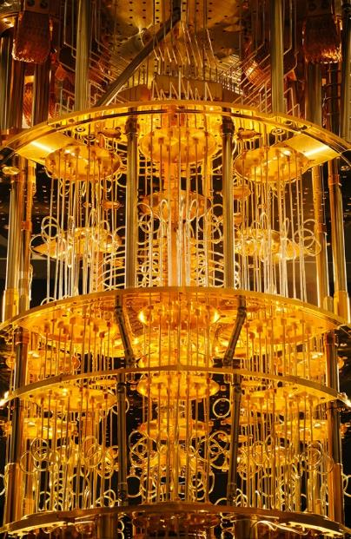
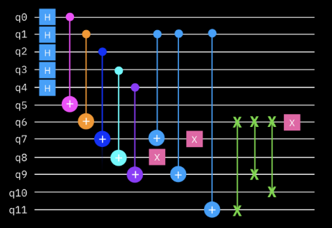



Foundations of
Quantum Information Science (QIS 101)
Dave Biersach
Brookhaven National Laboratory
dbiersach@bnl.gov
Session 23a
Quantum Circuits

Slide 2
Session 23a – Goals
Compare and contrast state transitions represented by real matrices (probabilities) vs. complex matrices (amplitudes)
Appreciate the crucial role of interference (phase cancellation) in the superposition of complex waves
Map Terry Rudolph's PETE box to the concept of superposition obtained by applying the Hadamard gate
Review IBM Qiskit and run it in a Jupyter notebook
Map the action of the CNOT, CCNOT, and CSWAP gates and understand how the support reversible computing
Represent gates via their action (operator) unitary matrices

Slide 3
Session 23a – Goals (Cont.)
Combine multiple inputs using the tensor product of matrices
Derive the Bloch Sphere to represent qubit state
Appreciate the limitations of the No Cloning Theorem
Leverage the difference between amplitude and probability to encode extra information into a qubit's phase

Slide 4
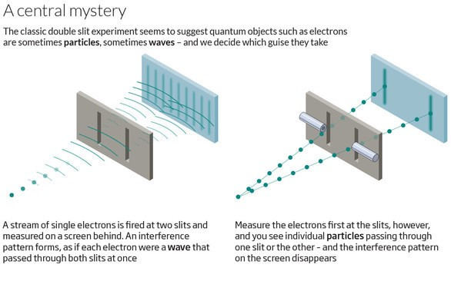
Quantum Double Slit Experiment

Slide 5
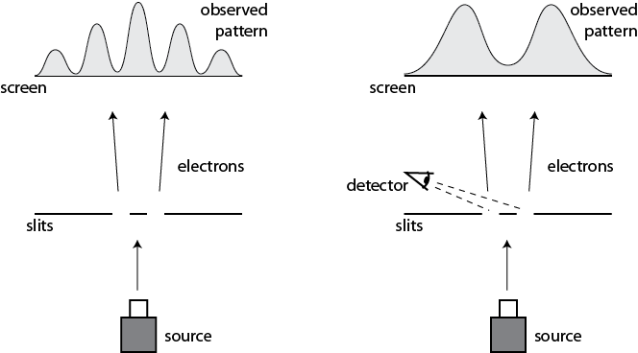
Quantum Double Slit Experiment
This happens even if we only allow a single electron at a time to pass through the slits

Slide 6
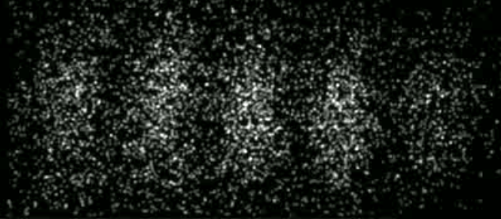
Quantum Double Slit Experiment
Time-Lapse Photograph of Single Electron Double-Slit Interference Pattern
In 1965, Richard Feynman called this the
"central mystery" of quantum theory, and then corrected himself, saying that in fact
"it is the only mystery"
Herman Batelaan, University of Nebraska-Lincoln, 2013

Slide 7
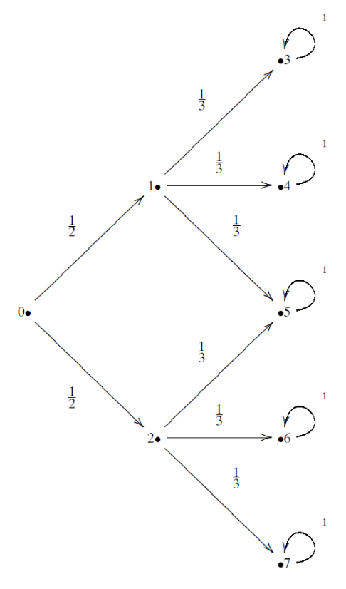
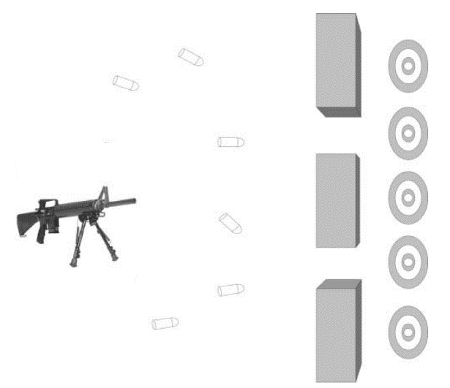
The Double Slit Experiment as a Matrix
Bullets
(Particles)
Transition Probability

Slide 8
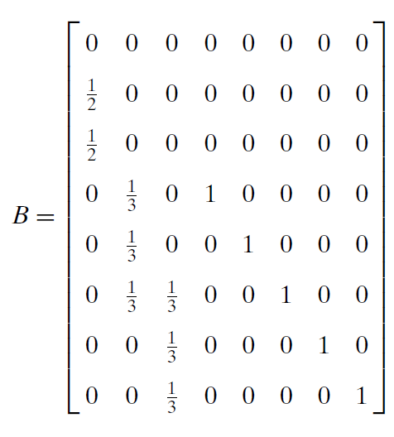
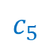
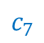
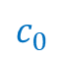
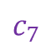
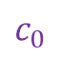
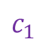
The Double Slit Experiment as a Matrix
FROM
$$c_{0}$$
$$c_{1}$$
$$c_{7}$$
$$c_{0}$$
TO
$$c_{5}$$
$$c_{7}$$
Bullet
Transition Probabilities For One Time Step

Slide 9
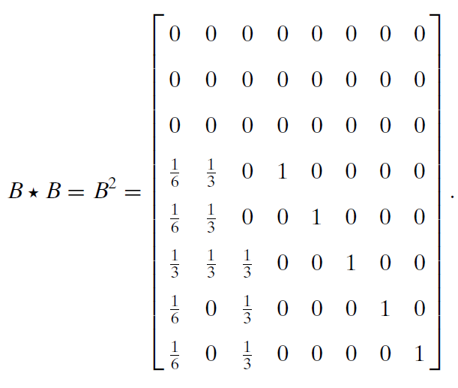
The Double Slit Experiment as a Matrix
Every time we multiple a transition matrix by itself,
we can calculate another time step (the next transition matrix)
Bullet
Transition Probabilities For
One Time Step
Bullet
Transition Probabilities After
Two Time Steps

Slide 10
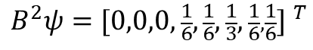
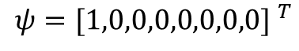
The Double Slit Experiment as a Matrix
Bullet Location Probabilities After Two Time Steps
$$ψ={[1,0,0,0,0,0,0,0] }^{T}$$
$$B^{2}ψ={[0,0,0,\frac{1}{6},\frac{1}{6},\frac{1}{3},\frac{1}{6},\frac{1}{6}] }^{T}$$

Slide 11
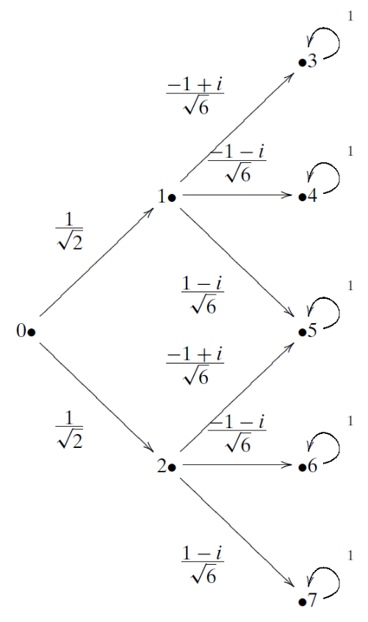
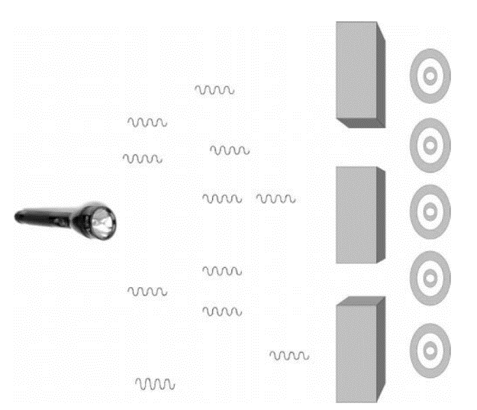
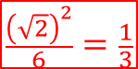
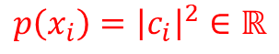
The Quantum Double Slit as a Matrix
Transition Amplitude
Photons
$$\frac{{\left(\sqrt{2}\right)}^{2}}{6}=\frac{1}{3}$$
$$\frac{1}{2}$$
When we square the norm of a transition amplitude, we get the transition probability
$$p\left(x_{i}\right)={\left|c_{i}\right|}^{2}∈ℝ$$

Slide 12
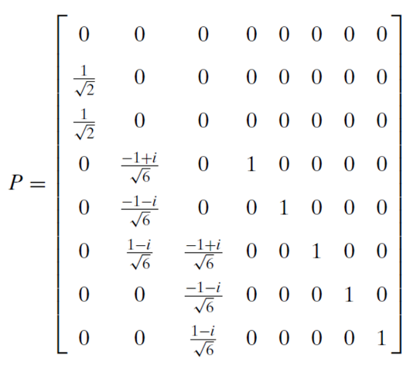
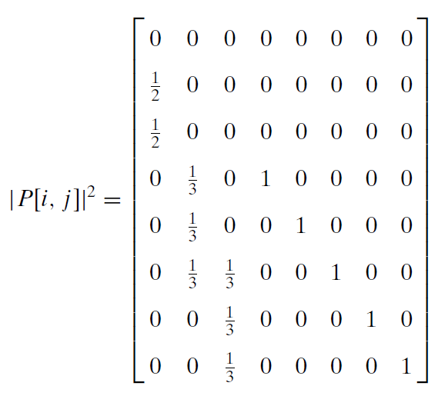
The Quantum Double Slit as a Matrix
When we measure a photon, its wave function collapses, and the norm squared of each amplitude becomes a probability
Photon
Transition Amplitudes For
One Time Step
Photon
Transition Probabilities For
One Time Step

Slide 13

The Quantum Double Slit as a Matrix
Once we measure the photon,
it acts like a bullet (a particle)…
$$=$$
Photon
Transition Probabilities For
One Time Step
Bullet
Transition Probabilities For
One Time Step

Slide 14
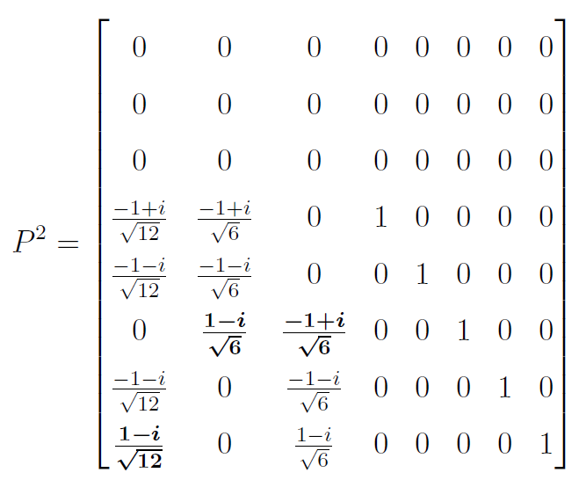

The Quantum Double Slit as a Matrix
If we do not measure the photon, we continue to use its transition amplitudes to calculate the next step…
$$P∙P$$
Photon
Transition Amplitudes For
One Time Step
Photon
Transition Amplitudes For
Two Time Steps

Slide 15
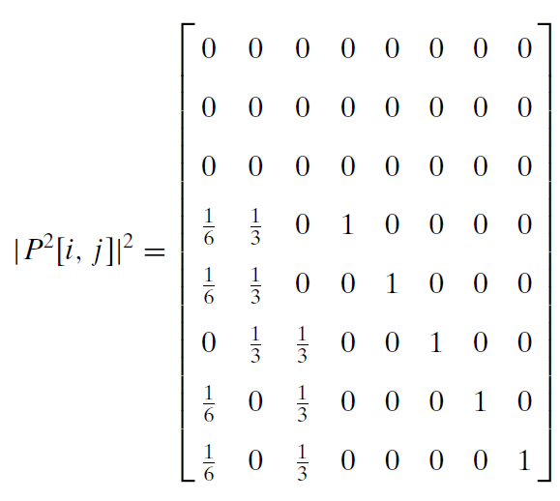
The Quantum Double Slit as a Matrix
If we measure the photon after the first step:
If we measure the photon only after the second step:
Photon
Transition Probabilities For
One Time Step
Photon
Transition Probabilities For
Two Time Steps

Slide 16

The Quantum Double Slit as a Matrix
If we wait to measure the photon only after two steps, we see it is acting like a wave (not like a particle)…
$$≠$$
Bullet
Transition Probabilities For
Two Time Steps
Photon
Transition Probabilities For
Two Time Steps

Slide 17
The Quantum Double Slit as a Matrix
Photons
Photon
Transition Probabilities For
Two Time Steps
The complex amplitudes in the photon's operator cause destructive interference

Slide 18
The Bloch Sphere
How can we visually represent a qubit on a printed page using only black & white ink?
$$\left.\left|ψ\right.\right\rangle =(a+bi)\left.\left|0\right.\right\rangle +(c+di)\left.\left|1\right.\right\rangle$$
It appears we must be able to plot four independent parameters: $\left(a,b,c,d\right)∈ℝ$
Therefore, we have a 4D object to visualize,
but we only have a 2D plane upon which we can draw
We cannot use the trick of indicating the 4th dimensional parameter using color in an oblique projection of a 3D surface

Slide 19
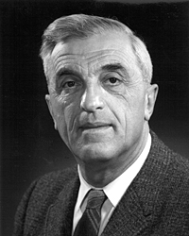
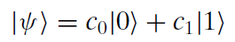
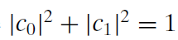
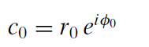
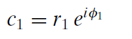
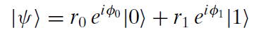
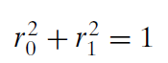
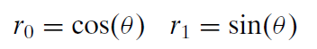
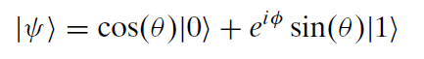
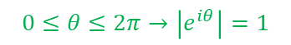


The Bloch Sphere
A complex number with a unit modulus is a point on a unit circle
A normalized ket
Euler's Formula
Felix Bloch
(1905-1983)
Substitution
Multiply ket by scalar
Killing the phase of $\left.\left|0\right.\right\rangle$
$$0≤θ≤2π→\left|e^{iθ}\right|=1$$
$$φ=φ_{1}−φ_{0}$$
Trig version of Pythagorean Theorem
Now only two real parameters remain: $θ$ and $φ$

Slide 20
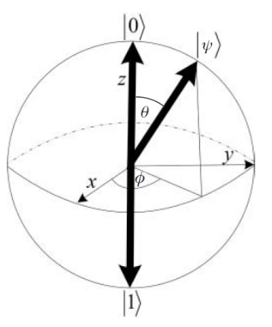
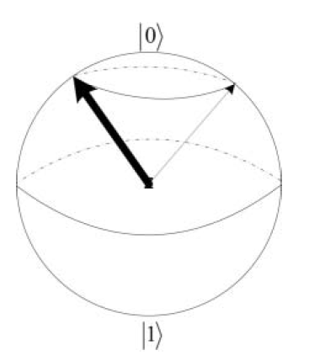
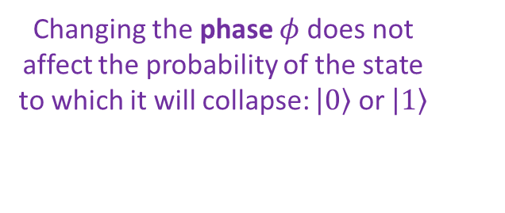
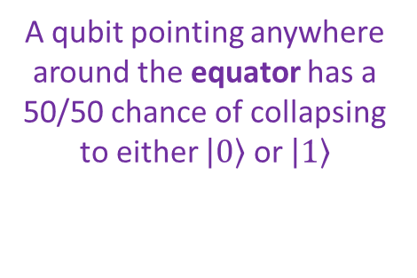
The Bloch Sphere
$$φ=φ_{1}−φ_{0}$$
A qubit pointing anywhere around the equator has a 50/50 chance of collapsing to either $\left.\left|0\right.\right\rangle$ or $\left.\left|1\right.\right\rangle$
Changing the phase $φ$ does not affect the probability of the state to which it will collapse: $\left.\left|0\right.\right\rangle$ or $\left.\left|1\right.\right\rangle$
Every unitary 2x2 operator (a quantum gate) will "rotate" this sphere in some way

Slide 21
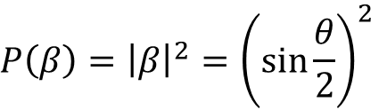
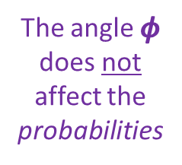
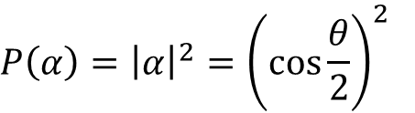
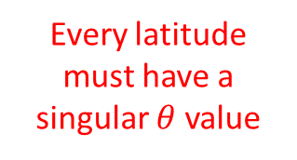
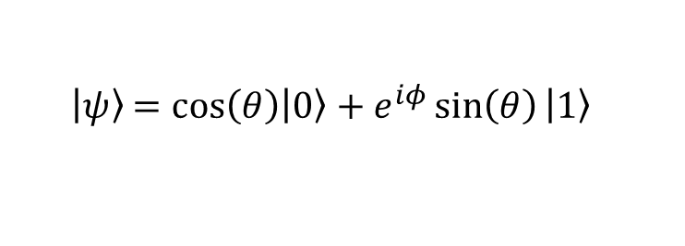
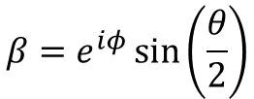
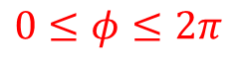
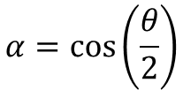
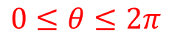
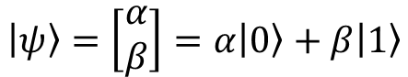
The Bloch Sphere
$\left|\left.ψ\right\rangle \right.$ $=\cos\left(θ\right)\left|\left.0\right\rangle \right.+e^{iφ}\sin\left(θ\right)\left|\left.1\right\rangle \right.$
Every latitude must have a singular $θ$ value
poloidal
$$0≤θ≤2π$$
toroidal
$$0≤φ≤2π$$
$$\left|\left.ψ\right\rangle \right.=\left[\begin{matrix}α \\ β\end{matrix}\right]=α\left|\left.0\right\rangle \right.+β\left|\left.1\right\rangle \right.$$
$$α=\cos\left(\frac{θ}{2}\right)$$
$$β=e^{iφ}\sin\left(\frac{θ}{2}\right)$$
$$P\left(α\right)={\left|α\right|}^{2}={\left(\cos{\frac{θ}{2}}\right)}^{2}$$
The angle $φ$ does not affect the probabilities
$$P\left(β\right)={\left|β\right|}^{2}={\left(\sin{\frac{θ}{2}}\right)}^{2}$$

Slide 22
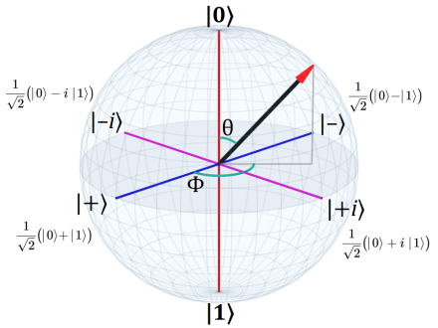
The Bloch Sphere

Slide 23















The Bloch Sphere
The
z basis
$\left|\left.ψ\right\rangle \right.$ $=\cos\left(θ\right)\left|\left.0\right\rangle \right.+e^{iφ}\sin\left(θ\right)\left|\left.1\right\rangle \right.$
$$0≤θ≤2π$$
$$\left|\left.ψ\right\rangle \right.=\left[\begin{matrix}α \\ β\end{matrix}\right]=α\left|\left.0\right\rangle \right.+β\left|\left.1\right\rangle \right.$$
$$0≤φ≤2π$$
Note: Probabilities require measurements, and we can't measure global phase $∴$ $φ=0$
$$α=\cos\left(\frac{θ}{2}\right)$$
$$β=\sin\left(\frac{θ}{2}\right)$$
$$θ=0$$
$$P\left(0\right)={\left(\cos{\frac{0}{2}}\right)}^{2}\left|\left.0\right\rangle \right.+{\left(\sin{\frac{0}{2}}\right)}^{2}\left|\left.1\right\rangle \right.={\left[\begin{matrix}1 & 0\end{matrix}\right]}^{T}$$
$\left|\text{0}⟩\right.$ in the z basis
$$θ=π$$
$$P\left(π\right)={\left(\cos{\frac{π}{2}}\right)}^{2}\left|\left.0\right\rangle \right.+{\left(\sin{\frac{π}{2}}\right)}^{2}\left|\left.1\right\rangle \right.={\left[\begin{matrix}0 & 1\end{matrix}\right]}^{T}$$
$\left|\text{1}⟩\right.$ in the z basis
$$θ=π/2$$
$$P\left(\frac{π}{2}\right)={\left(\cos{\frac{π}{4}}\right)}^{2}\left|\left.0\right\rangle \right.+{\left(\sin{\frac{π}{4}}\right)}^{2}\left|\left.1\right\rangle \right.={\left[\begin{matrix}\frac{1}{2} & \frac{1}{2}\end{matrix}\right]}^{T}$$
50/50 superposition

Slide 24





Unitary Matrices
$$\frac{1}{\sqrt{2}}\left[\begin{matrix}1 & 1 \\ 1 & −1\end{matrix}\right]=H$$
$$H∙H^{†}=I$$
Hadamard Gate
Hadamard Matrix is Unitary
0
$$\frac{1}{\sqrt{2}}\left[\begin{matrix}1 & 1 \\ 1 & −1\end{matrix}\right]\left[\begin{matrix}1 \\ 0\end{matrix}\right]=\frac{1}{\sqrt{2}}\left[\begin{matrix}1 \\ 1\end{matrix}\right]=\frac{\left.\left|0\right.\right\rangle +\left.\left|1\right.\right\rangle }{\sqrt{2}}$$
A Hadamard gate puts a qubit into a superposition of states, with a 50/50 chance of getting a 0 or 1
1
$$\frac{1}{\sqrt{2}}\left[\begin{matrix}1 & 1 \\ 1 & −1\end{matrix}\right]\left[\begin{matrix}0 \\ 1\end{matrix}\right]=\frac{1}{\sqrt{2}}\left[\begin{matrix}1 \\ −1\end{matrix}\right]=\frac{\left.\left|0\right.\right\rangle −\left.\left|1\right.\right\rangle }{\sqrt{2}}$$
$${\left(\frac{1}{\sqrt{2}}\right)}^{2}=\frac{1}{2}=50\%$$
Note: these are not the same states, yet they have the same expectation values (probabilities) of 50% zero, 50% one

Slide 25






Unitary Matrices
Here are some additional fundamental unitary matrices that can act on qubits:
Phase
"Shift"
Phase
"Twist"
$$X$$
$$Y$$

Slide 26



Unitary Matrices

Slide 27













Quantum Gates
Reversible?
In the quantum world, all operations that are not measurements must be reversible and must be represented by unitary matrices
$$U⋅U^{†}=U^{†}⋅U=I$$
$$I_{n}⋅I_{n}=I_{n}$$
Controlled NOT (CNOT)
$⊗=$ Tensor Product
Control Line
$$NOT⋅NOT=I$$
1
1
$⊕=$ Binary XOR
Yes
1
Target
0
x y
in
out
x y
Will act only if the control line
$\left.|x\right\rangle$ is 1
CNOT is reversible and universal for Quantum computing
No

Slide 28


Quantum Gates
Note: We cannot apply a negative phase angle to a target qubit in the $\left|\left.0\right\rangle \right.$ state, as $\left(−1\right)\left(0\right)=0$

Slide 29

Quantum Gates

Slide 30



Quantum Gates

Slide 31





Quantum Gates
The CCNOT is reversible and universal for both Boolean & Quantum computing
Controlled Controlled NOT (CCNOT)
x y z
in
Control Line 1
1
1
out
Control Line 2
1
1
$$x∧y =x AND y$$
0
1
Acts only if both controls $\left.|x\right\rangle$and $\left.|y\right\rangle$are 1
CCNOT is reversible
$$z$$ | $$X⋀Y$$ | $$Z⊕\left(X⋀Y\right)$$
0 | 0 | 0
1 | 0 | 1
0 | 1 | 1
1 | 1 | 0
A Toffoli Gate

Slide 32



Quantum Gates
Controlled Swap (CSWAP)
x y z
in
Control Line
1
1
out
1
0
0
1
If control $\left.|x\right\rangle$ is 1,
$\left.|y\right\rangle$ and $\left.|z\right\rangle$ values are swapped
CSWAP is reversible
The CSWAP is reversible and universal for Quantum computing
A Fredkin Gate

Slide 33


Quantum Gates
Gates like CNOT and CCNOT are made by combining unitary matrices like X, Y, Z, S, T, and H
CNOT
CCNOT

Slide 34



Quantum Gates
We can create a SWAP gate using three CNOT gates or six Hadamard Gates + three CZ Gates
The unitary matrix for a SWAP gate

Slide 35

Quantum Gates

Slide 36




Amplitude vs. Probability
Addition is Commutative, Subtraction is NOT
Note: these two are not the same states, yet they have the same expectation values (probabilities)

Slide 37









Amplitude vs. Probability
$\sqrt{NOT}$ is Unitary
$$\left(\sqrt{NOT}\right)⋅{\left(\sqrt{NOT}\right)}^{†}=I$$
$$A⋅A=A^{2}$$
$$A⋅A^{†}=I$$
$$\sqrt{NOT}$$
$$\sqrt{NOT}$$
But are these two "zeros" the same state?
Scalar multiplication of $\left.\left|ψ\right.\right\rangle$ does not change the probabilities
$$\left.\left(s\right)\left|ψ\right.\right\rangle ⟼p\left(x_{i}\right)$$
Refer to these:
Session 14a - Slide 65
Session 22 - Slide 50

Slide 38

Representing Multiple Qubits
$${\left[\begin{matrix}0 \\ 1\end{matrix}\right]}^{⨂3}=\left[\begin{matrix}0 \\ 1\end{matrix}\right]⨂\left[\begin{matrix}0 \\ 1\end{matrix}\right]⨂\left[\begin{matrix}0 \\ 1\end{matrix}\right]$$
$$=\left[\begin{matrix}0 \\ 1\end{matrix}\right]⨂\left[\begin{matrix}\left(0\right)\left[\begin{matrix}0 \\ 1\end{matrix}\right] \\ \left(1\right)\left[\begin{matrix}0 \\ 1\end{matrix}\right]\end{matrix}\right]=\left[\begin{matrix}0 \\ 1\end{matrix}\right]⨂\left[\begin{matrix}0 \\ 0 \\ 0 \\ 1\end{matrix}\right]$$
0
$$=\left[\begin{matrix}\left(0\right)\left[\begin{matrix}0 \\ 0 \\ 0 \\ 1\end{matrix}\right] \\ \left(1\right)\left[\begin{matrix}0 \\ 0 \\ 0 \\ 1\end{matrix}\right]\end{matrix}\right]=\left[\begin{matrix}0 \\ 0 \\ 0 \\ 0 \\ 0 \\ 0 \\ 0 \\ 1\end{matrix}\right]=\left|\left.111\right\rangle \right.$$
$${111}_{2}=7_{10}$$
7

Slide 39









Representing Multiple Qubits
0
1
1
0
1
0
1
1
A qubyte
$${\left(ℂ^{2}\right)}^{⊗8}=ℂ^{256}$$
A Quantum Register
0
A classical computer would have to store 256 potentially complex numbers to fully simulate a single qubyte!
107
255

Slide 40







Run Cells 1 to 7 – quantum_gates.ipynb
Demonstrate the following seven identities by applying the operator matrices for quantum gates
$$\#1) X^{2}=Y^{2}=Z^{2}=I$$
$$\#5) −1Y=HYH$$
$$\#2) H=\frac{1}{\sqrt{2}}(X+Z)$$
$$\#6) {S=T}^{2}$$
$$\#3) X=HZH$$
$$\#7) −1Y=XYX$$
$$\#4) Z=HXH$$

Slide 41


Run Cell 1 quantum_gates.ipynb
①
②
③
④
⑤
⑥
⑦
⑧

Slide 42






Run Cells 2 to 4 – quantum_gates.ipynb

Slide 43









Run Cells 5 to 7 – quantum_gates.ipynb
$$T⋅T=T^{2}$$
$$T⋅T^{†}=I$$
$$T^{2}≠\left\langle T | T\right\rangle$$

Slide 44


No Cloning Theorem
Can we send the same input qubit to two different output lines?
Controlled Swap (CSWAP)
Controlled Controlled NOT (CCNOT)
A NOT symbol
Can we use a CSWAP to produce a fanout?
Can we use a CCNOT to produce a fanout?
A Fredkin Gate
A Toffoli Gate

Slide 45










No Cloning Theorem
"We can cut-n-paste, but not copy-n-paste"
$$\left.\left|x\right.\right\rangle =\frac{\left.\left|0\right.\right\rangle +\left.\left|1\right.\right\rangle }{\sqrt{2}}=\left[\begin{matrix}\frac{1}{\sqrt{2}} \\ \frac{1}{\sqrt{2}}\end{matrix}\right]$$
$x$ is in superposition
$$x=0/1,y=1, z=0$$
$$y$$
$$z$$
in
out
in
$$\frac{\left|\left.0,1,0\right\rangle \right.+\left|\left.1,1,0\right\rangle \right.}{\sqrt{2}}$$
out
$$\frac{\left|\left.0,1,0\right\rangle \right.+\left|\left.1,0,1\right\rangle \right.}{\sqrt{2}}$$
The output state is not an exact copy of the input state

Slide 46

Impress Me
Show how the CCNOT gate shown on slide #31 cannot exactly clone this input state: $x=\left|\left.1\right\rangle \right.$, $z=\left|\left.0\right\rangle \right.$, and $y$ is a 50/50 superposition:
$$\frac{\left|\left.1,0,0\right\rangle \right.+\left|\left.1,1,0\right\rangle \right.}{\sqrt{2}}$$
Note: the no cloning theorem says you cannot clone any arbitrary state (e.g., all possible states) but you might be able to clone a single specific state

Slide 47

IBM Qiskit
https://qiskit.org

Slide 48

IBM Qiskit
https://qiskit.org/learn

Slide 49

IBM Qiskit
https://qiskit.org/textbook

Slide 50

IBM Qiskit
Qiskit Foundations - Coding With Qiskit - Season 1

Slide 51



IBM Qiskit Elements

Slide 52
IBM Qiskit Elements
Algorithms
Chemistry
Finance
Machine Learning
QasmSimulator
StatevectorSimulator
UnitarySimulator
Characterization
Mitigation
Verification
Measurement
Logging
qiskit.circuit
qiskit.visualization
qiskit.transpiler
qiskit.providers
Backend
Job
Result

Slide 53

Run Cell 1 qiskit_elements.ipynb
①
Qiskit is continuously updated, so the version numbers of the packages installed on your machine will likely be greater than those shown here

Slide 54

Phase Encoding
Because the amplitudes of a qubit can be negative complex numbers, we can encode information in the qubit's phase
$$\left|\left.ψ\right\rangle =c_{0}\left|\left.0\right\rangle \right.+c_{1}\left|\left.1\right\rangle \right.\right.$$
We lose this phase information when we measure a qubit because probabilities must be exclusively positive real numbers
But while a quantum state evolves, coaxed on by a quantum circuit/algorithm, we can leverage these negative complex phases to induce destructive interference
The phase of one qubit can be used to influence the phase of other qubits in the circuit

Slide 55



Phase Encoding
A pure classical state can only be 0 or 1, but a pure qubit state could have a variety of "equal" amplitudes:
Remember we take the norm (absolute value) squared of the amplitudes to determine the expected value (the Born Rule), so the top row would all measure as 0, and the bottom row would all measure as 1
A key when designing quantum algorithms is to deftly leverage all four ways a pure state can be encoded as a complex amplitude ☺
$$\left|\left.0\right\rangle \right.$$
$$\left[\begin{matrix}1 \\ 0\end{matrix}\right]$$ | $$\left[\begin{matrix}−1 \\ 0\end{matrix}\right]$$ | $$\left[\begin{matrix}i \\ 0\end{matrix}\right]$$ | $$\left[\begin{matrix}−i \\ 0\end{matrix}\right]$$
$$\left[\begin{matrix}0 \\ 1\end{matrix}\right]$$ | $$\left[\begin{matrix}0 \\ −1\end{matrix}\right]$$ | $$\left[\begin{matrix}0 \\ i\end{matrix}\right]$$ | $$\left[\begin{matrix}0 \\ −i\end{matrix}\right]$$
$$\left|\left.1\right\rangle \right.$$

Slide 56







Run Cell 1 phase_encoding.ipynb
①
②
③
Qubits start in pure zero state
④
$$\left|0⟩\right.$$
⑤
⑥
⑦
⑧
When measured…
⑨
$$\left|\left.0\right\rangle \right.→\left[\begin{matrix}−1 \\ 0\end{matrix}\right]→\left[\begin{matrix}1 \\ 0\end{matrix}\right]→0$$
⑩

Slide 57








Run Cell 2 phase_encoding.ipynb
①
②
$$\left|0⟩\right.$$
③
④
When measured…
⑤
$$\left|\left.0\right\rangle \right.→\left[\begin{matrix}i \\ 0\end{matrix}\right]→\left[\begin{matrix}1 \\ 0\end{matrix}\right]→0$$
⑥

Slide 58








Run Cell 3 phase_encoding.ipynb
①
②
$$\left|0⟩\right.$$
③
④
⑤
$$\left|\left.0\right\rangle \right.→\left[\begin{matrix}−i \\ 0\end{matrix}\right]→\left[\begin{matrix}1 \\ 0\end{matrix}\right]→0$$
⑥

Slide 59





Run Cell 4 phase_encoding.ipynb
①
②
③
④
Same quantum circuit as Cell 3
⑤
⑥
3 decimal places
⑦
$$\left|\left.0\right\rangle \right.→\left[\begin{matrix}−i \\ 0\end{matrix}\right]→\left[\begin{matrix}1 \\ 0\end{matrix}\right]→0$$
⑧

Slide 60




Run Cell 5 phase_encoding.ipynb
①
$$\left|\left.0\right\rangle \right.→\left[\begin{matrix}0 \\ −1\end{matrix}\right]→\left[\begin{matrix}0 \\ 1\end{matrix}\right]→1$$

Slide 61




Run Cell 6 phase_encoding.ipynb
①
$$\left|\left.0\right\rangle \right.→\left[\begin{matrix}0 \\ i\end{matrix}\right]→\left[\begin{matrix}0 \\ 1\end{matrix}\right]→1$$

Slide 62




Run Cell 7 phase_encoding.ipynb
①
$$\left|\left.0\right\rangle \right.→\left[\begin{matrix}0 \\ −i\end{matrix}\right]→\left[\begin{matrix}0 \\ 1\end{matrix}\right]→1$$

Slide 63





Run Cell 8 phase_encoding.ipynb
①
②
Same quantum circuit as Cell 7
③
④
$$\left|\left.0\right\rangle \right.→\left[\begin{matrix}0 \\ −i\end{matrix}\right]→\left[\begin{matrix}0 \\ 1\end{matrix}\right]→1$$
⑤

Slide 64
Session 23a – Now You Know…
Due to the cancelling effects of complex amplitudes, wavefunctions can exhibit destructive interference
Each qubit we track in a circuit exponentially increases the output vector space (number of elements in the state vector) due to tensor multiplication
Quantum gates can be represented by unitary matrices as all computation effects must be reversible
Toffoli (CCNOT) and Fredkin (CSWAP) are universal gates
The No Cloning Theorem prevents making an exact copy of any qubit – but we can "copy" the probabilities of reading a qubit's values (just not both the probability and the phase)

Slide 65
Session 23a – Now You Know…
IBM Qiskit is a premier development toolkit for writing quantum computer algorithms in Python
You can experiment with the Qiskit libraries within interactive Jupyter notebooks by executing cells of code
You can encode extra information into a qubit's phase because sign and imaginary values are lost when we take the norm squared of an amplitude to determine its probability

